Slide 1
Evolving Kubernetes
Jack Xue
2023-08-17

Slide 2
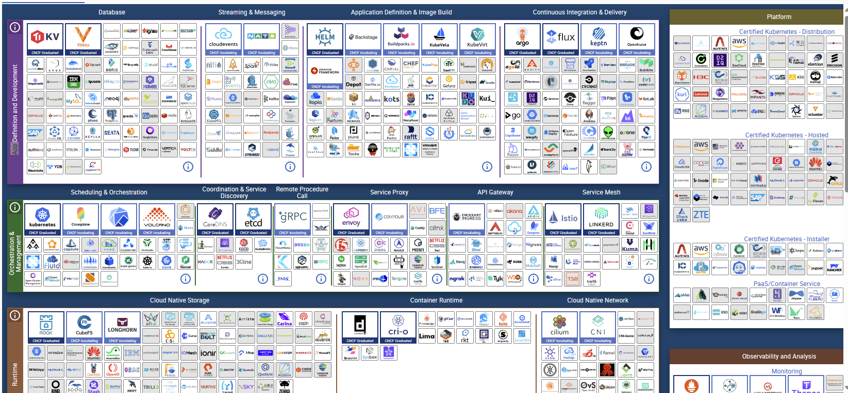
CNCF: Cloud Native Computing Foundation
Cloud Native Landscape (cncf.io)

Slide 3
KEDA: Kubernetes Event-Driven Autoscaler
It is built to be able to activate a Kubernetes deployment (i.e. no pods to a single pod) and subsequently to more pods based on events from various event sources.
Azure Container Apps
HTTP traffic
Event-driven processing
CPU or memory load
Any KEDA-supported scaler

Slide 4
ISTIO + Envoy for Service Mesh
Modern applications are typically architected as distributed collections of microservices. A service mesh allows you to transparently add capabilities like observability, traffic management, and security, without adding them to your own code.
Istio are made up of both a control plane and a data plane. Istio uses an extended version of Envoy as its data plane. Envoy then manages all inbound and outbound traffic in the Istio service mesh.
Envoy is a popular open-source edge and service proxy that provides advanced load balancing, routing, and observability features. It is often used in Kubernetes as a sidecar
AKS Add-on

Slide 5
DAPR: Distributed Application Runtime
Dapr helps you tackle the challenges that come with building microservices and keeps your code platform agnostic.
In particular, it helps solve problems around services:
Calling other services reliably and securely
Building event-driven apps with pub-sub
Building applications that are portable across multiple cloud services and hosts (for example, Kubernetes vs. a VM)
AKS Extension

Slide 6
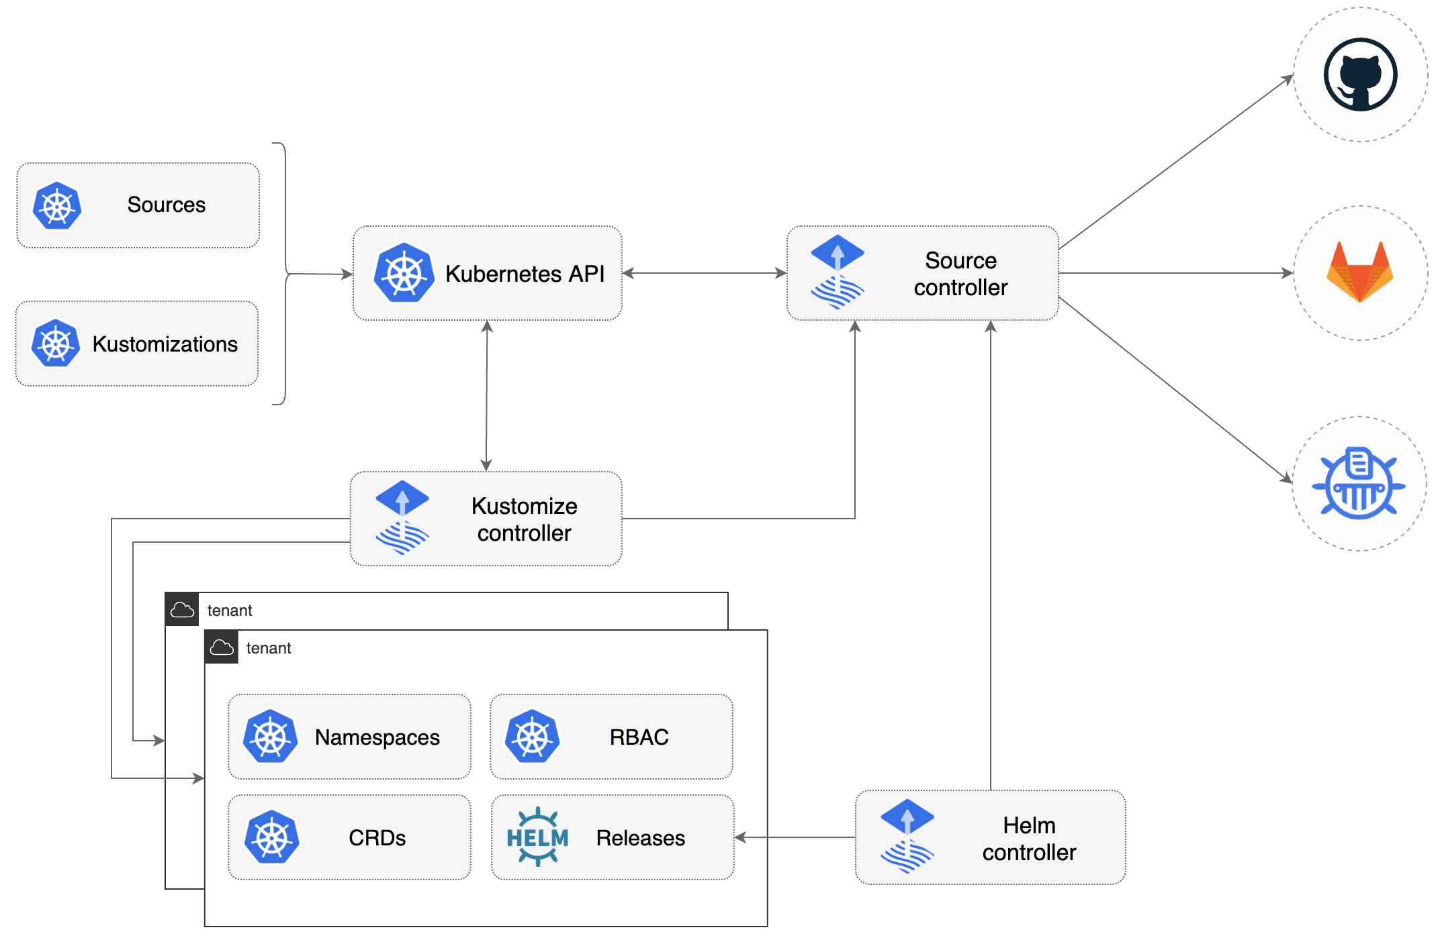
GitOps in Action: Flux Project
Tutorial: Deploy applications using GitOps with Flux v2 - Azure Arc | Microsoft Learn

Slide 7
Reference
GitOps with Flux GitOps Toolkit components | Flux (fluxcd.io)
gRPC with What is Azure Application Gateway Ingress Controller? | Microsoft Learn
ISTIO for service mesh Istio-based service mesh add-on for Azure Kubernetes Service (preview) - Azure Kubernetes Service | Microsoft Learn
DAPR for portable microservices Dapr - Distributed Application Runtime
Look at the landscape of CNCF Cloud Native Landscape (cncf.io)

